Slide 1



Slide 2



 | Slope Bins 4 | Smear Count 25
Block number | Alpha w/ Henderson Hasselbalch | Chi Chi_max = 2.2
[0 50] | 0.040012 | 1.160000
[50 75] | -0.278451 | 0.720000
[75 125] | -0.519707 | 0.608000
[125 156] | -0.154453 | 0.529032

Slide 3


 | Slope Bins 4 | Smear Count 31
Block number | Alpha w/ Henderson Hasselbalch | Chi Chi_max = 2.2
[0 31] | 0.001103 | 0.922581
[31 62] | -0.386873 | 0.703226
[62 93] | -0.290146 | 0.967742
[93 496] | 0.037164 | 1.098759
[496 527] | -0.064533 | 0.819355
[527 620] | 0.010682 | 0.756989
[620 647] | -0.103326 | 0.696296

Slide 4
Binary results

Slide 5





All plotting wrong L pure; look only at purp
NFL
NFH
H volume too low to neutralize L (v = 31 nm3/c)

Slide 6







H volume v = 60 nm3/c

Slide 7




For i as L and H:
Pure height profiles
Mixed height profiles
Current L library
Current H library

Slide 8
L/H Fitting

Slide 9







v2.7 and some fine
b1.50 v2.7 c3.2
b1.75 v2.7 c3.2
b1.75 v2.5 c3.2
b1.75 v2.5 c3.0
b2.0 v2.7 c3.2
b2.25 v2.7 c3.2
b2.50 v2.7 c3.2
Phi too small to decrease v0

Slide 10










b2.0 v2.0 c3.0
b2.0 v10.0 c3.0
b2.0 v8.0 c3.0
b2.0 v6.0 c3.0
b2.0 v4.0 c3.0
Phi limit
b1.8 v10.0 c3.0
b1.8 v8.0 c3.0
b1.8 v6.0 c3.0
b1.8 v3.0 c3.0
b1.8 v2.0 c3.0
Phi limit

Slide 11





b1.6 v10.0 c3.0
b1.6 v8.0 c3.0
b1.6 v6.0 c3.0
b1.6 v2.0 c3.0
b1.6 v1.5 c3.0
Phi limit

Slide 12









b2.0 v2.7 c3.2
b3.0 v3.5 c3.5
b3.0 v7.0 c3.5
b3.0 v7.0 c3.0
Phi too small
Phi too small to decrease v0
b4.0 v12.0 c3.0
b5.0 v20.0 c3.0
b5.0 v20.0 c4.0
b5.0 v5.0 c3.0
b5.0 v10.0 c3.0
Phi too small to decrease v0

Slide 13





v20
b5.0 v20.0 c3.0
b4.5 v20.0 c3.0
b4.0 v20.0 c3.0
b3.5 v20.0 c3.0
v10
b5.0 v10.0 c3.0
b4.0 v10.0 c3.0
b3.0 v10.0 c3.0
b2.0 v10.0 c3.0

Slide 14


Response to stimuli given composition
Same data
Effect of composition given environment

Slide 15
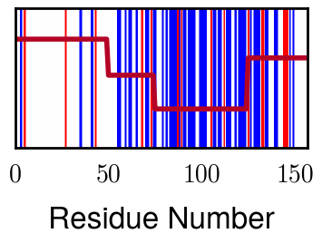

NFL, pH 7.44, phos 1.5e (from LCMS)
Non-phos NFL
Block number | Alpha w/ Henderson Hasselbalch | Chi Chi_max = 2.2
[0 50] | 0.040012 | 1.160000
[50 75] | -0.278451 | 0.720000
[75 125] | -0.519707 | 0.608000
[125 156] | -0.154453 | 0.529032
 | Slope Bins 4 | Smear Count 25
Block number | Alpha w/ Henderson Hasselbalch | Chi Chi_max = 3.2
[0 50] | -0.019988 | 1.540000
[50 75] | -0.278451 | 0.960000
[75 125] | -0.519707 | 0.868000
[125 156] | -0.154453 | 0.690323

Slide 16
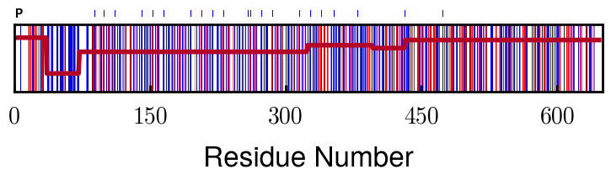

NFH, pH 7.44, phos 1.5e (from LCMS)
 | Slope Bins 4 | Smear Count 36
Block number | Alpha w/ Henderson Hasselbalch | Chi Chi_max = 3.2
[0 36] | 0.000945 | 1.266667
[36 72] | -0.527455 | 0.900000
[72 324] | -0.208376 | 1.729365
[324 396] | -0.111195 | 1.416667
[396 432] | -0.152824 | 1.344444
[432 647] | -0.033955 | 1.077209
X marking -1.5 seem wrong

Slide 18




b2.00 v2.70 c3.20
b2.00 v2.75 c3.20

Slide 19
NFH fitting (from NFL best fit)

Slide 20








b1.00, v0.50, c3.2
b2.00, v4.00, c3.2, th2.5e-02
b1.00, v2.00, c3.2
b1.00, v1.00, c3.2

Slide 21
Mixture

Slide 22



Slide 23


b = 0.75

Slide 24





Slide 25
b = 1.0

Slide 26





Slide 27
b = 1.25

Slide 28




Chi 2.6
Bad vol frac

Slide 29








b25v0
b25v1
b25v2
b25v3

Slide 30




Chi 2.8
Bad vol frac

Slide 31





Slide 32
b = 1.50

Slide 33






Chi 2.8
Bad vol frac

Slide 34





Slide 35

b = 2.00
v4 = 0.25*b^3

Slide 36


Bad vol frac

Slide 37



Slide 38
Fine tune

Slide 39



b1.25, v1.95, c3.0
b1.50, v3.38, c3.0
b2.00, v4.00, c3.0
Norm seems to capture kinked behavior

Slide 40




Slide 41



b1.25, v1.95, c3.2
b1.50, v3.38, c3.2
b2.00, v4.00, c3.2

Slide 42




Slide 43


b1.25
b1.50
b2.00
c2.8
c3.0
c3.2

